Slide 1



Innovative Digital Skills & Teaching Methods 4 Effective Health Education in Lebanon & Syria
mailto:digihealth.education@gmail.com

Slide 2

Agenda
What is DIGIHEALTH project
Why DIGHEALTH project
DIGIHEALTH Funding
DIGIHEALTH Partners
Expected Results & Benefits
DIGIHEALTH Work Packages
Teacher Survey

Slide 3
What is DIGIHEALTH Project
Promoting excellence, creative and innovative digital teaching and learning approaches through advanced ICT solutions to improve quality of health education in order to prepare a well-qualified graduates who are able to adapt to changing healthcare environment, meet societal expectations and sustain healthy environment in Lebanon and Syria

Slide 4
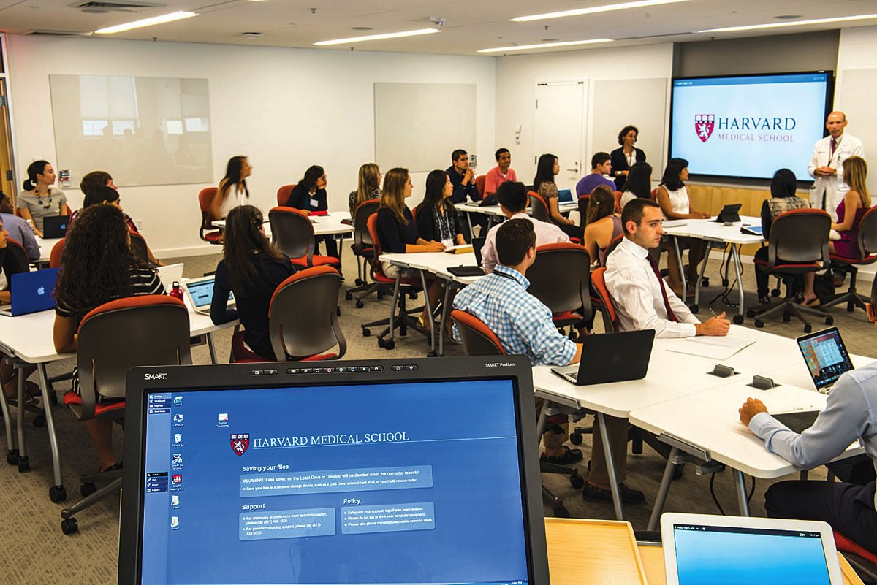
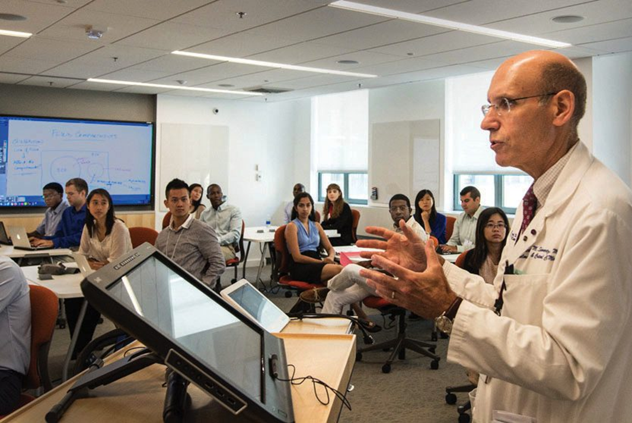
Why DIGIHEALTH?
The Harvard Magazine, September-October 2015
On the first day of the new curriculum’s launch, Gordon professor of medical education Richard Schwartzstein leads an orientation in a large group classroom equipped with interactive technologies that facilitate case-based collaborative learning
Notes:
On the first day of the new curriculum’s launch, Gordon professor of medical education Richard Schwartzstein leads an orientation in a large group classroom equipped with interactive technologies that facilitate case-based collaborative learning

Slide 5
“If we teach today’s students as we taught yesterday’s, we rob them of tomorrow.”
John Dewey

Slide 6
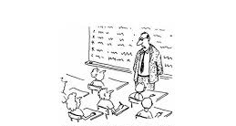
Teacher-Centered approach : (Robot) :Will the student experience more
Be more important than the course content?
Monopoly of Knowledge
Teacher
Content+ Form
focus on fact memorization
Curricula
Student

Slide 7
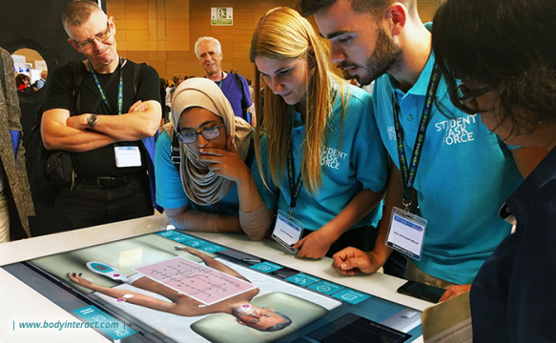
Student-Centered approach:
Modern education is learning, not teaching & qualified Teachers = Successful Learners Teach students to critically appraise and synthesize information rather than focus on fact memorization
TECHNOLOGY
New generation of learners
Student: Skills & competencies
Changing curricular emphasis —competencies and milestones
Need for life-long learning
Curricula
Facilitator

Slide 8
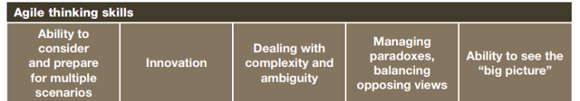
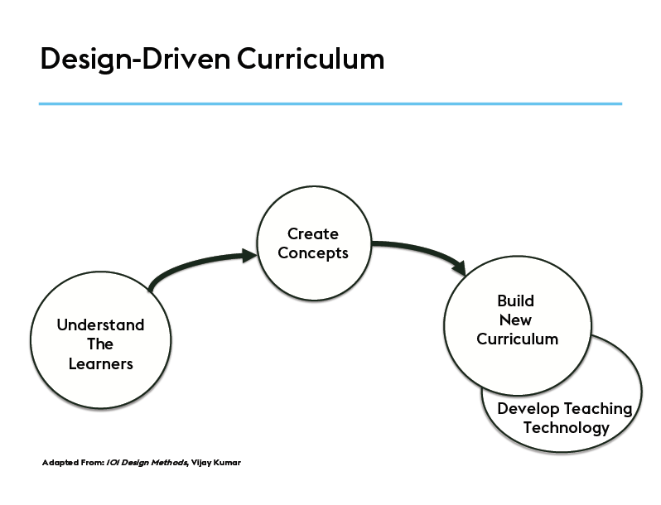
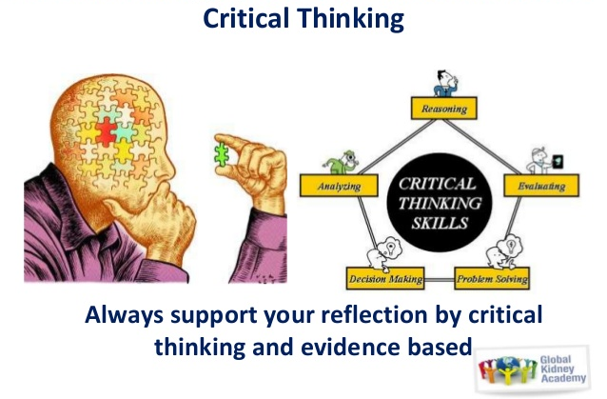
New Skills and Competencies
Design Thinking (T)
Critical Thinking (T&S)

Slide 9

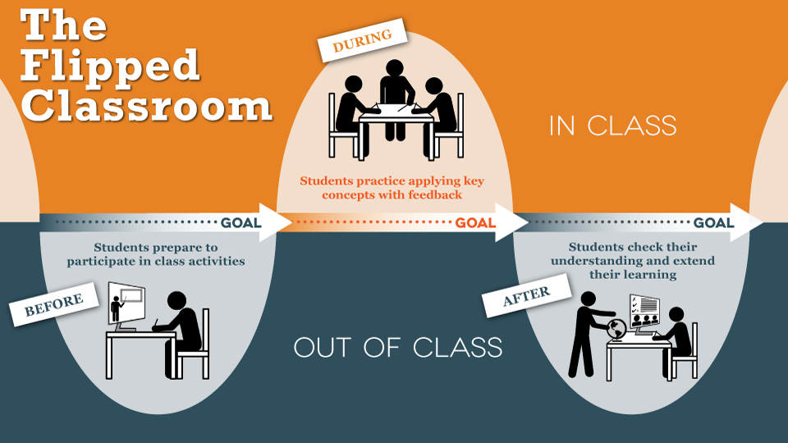
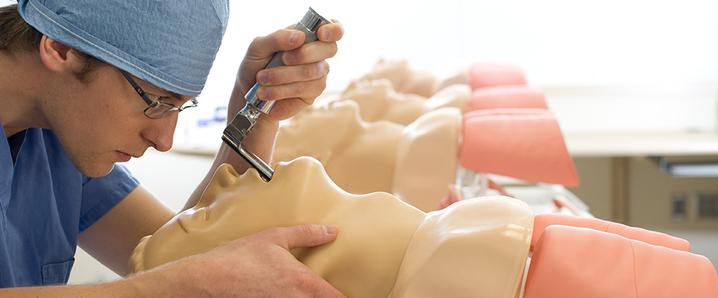
Technology-Enhanced Education
Digital Skills
flipped Classroom
Simulation

Slide 10
How to shift from traditional methods of classroom-based teaching to an up-dated constructivist approach of student- centred learning
Medical education is not about the transmission of information, but about the transformation of the learner.
Transformative learning environment:
with the physical spaces
with the way the curriculum is structured and taught
knowledge through lectures and texts to create knowledge and collaborate

Slide 11
How to shift from traditional methods of classroom-based teaching to an up-dated constructivist approach of student- centred learning
Support Lebanese and Syrian HEIs in adopting and implementing effective new technologies of digital skills and learning methods for an active and collaborative learning.
Develop the ability of academic staff at health disciplines in Lebanese and Syrian HEIs to employ modern pedagogical and didactical methodologies for innovative ICT teaching and learning settings.
Open up higher education in Lebanon and Syria to integrate refugees, IDPs and students from disadvantaged groups including women and rural areas inhabitants in inclusive virtual classroom settings.

Slide 12
Who is the funder EU 2020 STRATEGY "smart, sustainable, inclusive growth"
Increase the skills and employability of students and contribute to the competitiveness of EU economy.
Implement the Higher Education Modernizations strategy in program countries and raise the capacity of partner countries.
Improve quality in teaching & learning.
Streamline the international dimension in Erasmus+.

Slide 14
PARTNER COUNTRIES, neighboring EU

Slide 15
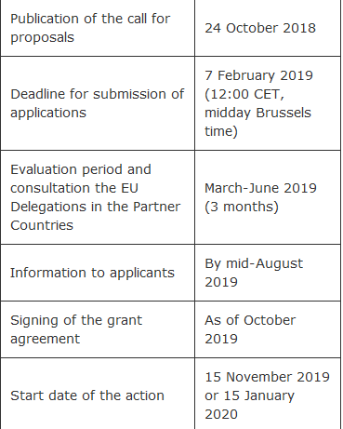
Capacity Building in Higher Education

Slide 16
DIGIHEALTH Consortium (Program Countries)
Linnaeus University (Sweden)
Project Coordinator
Grant Holder
University of Genoa (Italy)
Project Advisor
Know-How Provider
Universidad de Santiago de Compostela (Spain)
Know-How Provider
Mediterranean Universities Union (Italy)
Quality Control

Slide 17
DIGIHEALTH Consortium (Partner Countries Lebanon)
Lebanese University
National Educational Technology Training Centre
Beneficiary
Lebanese International University
Smart Classroom
Beneficiary
Beirut Arab University
Beneficiary
Smart Classroom
Modern University for Business and Science
National Contact Person
Beneficiary
Smart Classroom

Slide 18
DIGIHEALTH Consortium (Partner Countries Syria)
Damascus University
National Centre
Beneficiary
Arab International University
Project Operational Manager
Educational Technology Training Centre
Beneficiary
University of Hama
Smart Classroom
Beneficiary

Slide 19
Expected Results & Benefits
Educational Technology Training Centre
HR Capacity Building
10 Modules Redeveloped
10 E-Modules Developed
Modern Pedagogy
ICT Integration

Slide 20
DIGIHEALTH Target Groups / Beneficiaries
Students [ID](Benefit from the project in the long term)
Academic Staff [D] (Beneficiaries of the project)
Trainers (Users of the activities developed by the project)
Center Administrative Staff

Slide 21
DIGIHEALTH Work Packages (WP)
WP1: laying-down foundation of DIGIHEALTH (in process))
WP2: Capacity building (in process)
Remaining WPs:
WP3: Centers set-up at LU and DU
WP4: Quality assurance and evaluation
WP5: Dissemination and Exploitation
WP6: Management
WP7: Sustainability

Slide 22
Teacher Survey
https://forms.gle/j4M6WC4hQGrynbL78

Slide 23
Thank you for your Listening
Questions

